Slide 1

Thrifty Website for Second-hand Electronic Gadgets
Using Agile Model for Development

Slide 2
What is Thrifty?
A website to buy and sell second-hand electronics
gadgets
Example: phones, laptops, accessories
Goal: Make buying cheaper and help reduce e-waste

Slide 3
Why Agile Model?
Work is done in small parts (sprints)
Easy to change or improve the project
Get feedback faster
Good for teamwork

Slide 4
Scrum Roles
Role | Responsibility
Product Owner | Decides what features to make
Scrum Master | Helps team follow the rules
Team Members | Build and test the website

Slide 5
Product Backlog (Features List)
Login / Signup
Add products to sell
Search and filter items
Admin panel to manage site
Chat between buyer and seller
Save favorite items
Ratings / Reviews

Slide 6
Sprint Plan
Sprint 1: Login & signup
Sprint 2: Product listing & search
Sprint 3: Admin panel
Sprint 4: Reviews, Recommendation
Sprint 5: Testing & deployment

Slide 7
Daily Scrum
A 15- minute team meeting
Each member shares:
What they did yesterday
What they will do today
Any problems they face

Slide 8
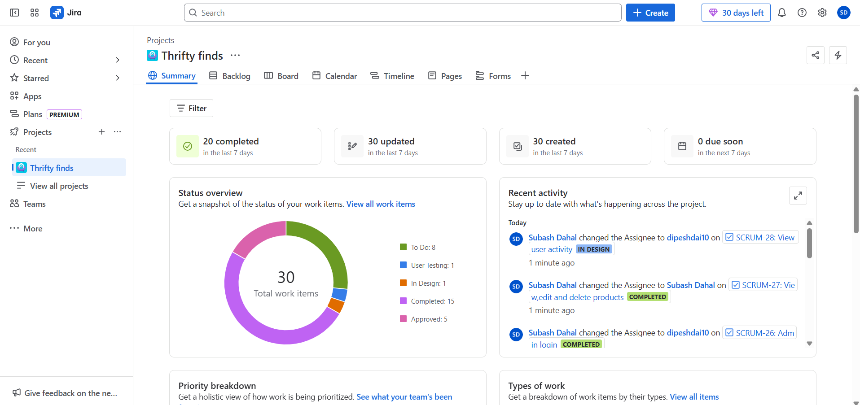
Summary of our work progess in Jira

Slide 9
After Sprint: Review & Improve
Sprint Review:
Show what we built
Get feedback from friend and mentor
Sprint Retrospective:
What was hard?
What should we improve next time?

Slide 10
Thank
You !

